Slide 1
Implementation of Median Filter on Z -Board and AWS
Reconfigurable Computing – Project.
By,
Anushka Swarup,
Medini J. Aradhya
Liming Xu

Slide 2
Project Description :
The Median Filter is a nonlinear digital filtering technique for removal of noise from images.
It works particularly well for certain types of random noises like the salt and pepper noise.
This method is often used as a preprocessing step for edge detection algorithms. It is advantageous as this method better preserves the edges in certain instances.
The amazon web services cloud platform is compatible with existing FPGA algorithms hence makes it a versatile open source platform for accelerated computing.
Notes:
medini

Slide 3
Software Algorithm – MATLAB
Medfilt2() – 2D Median Filtering
J = medfilt2(I)
performs median filtering of the image I in two dimensions.
Each output pixel contains the median value in a 3-by-3 neighborhood in the input image.
Notes:
anushka

Slide 4
Software Algorithm – C++
Notes:
anushka

Slide 5
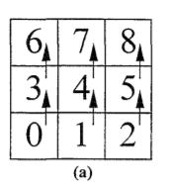
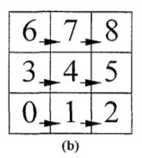
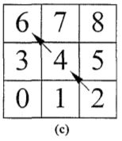
Hardware Algorithm
Vertical Sort
Abc..
Horizontal Sort
Diagonal Sort
Notes:
Liming

Slide 6
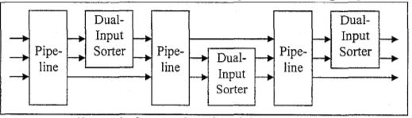
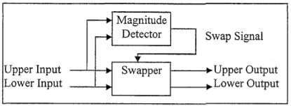
Hardware Algorithm
Notes:
Liming

Slide 7
Datapath Details :
Abc..
Notes:
Liming

Slide 8
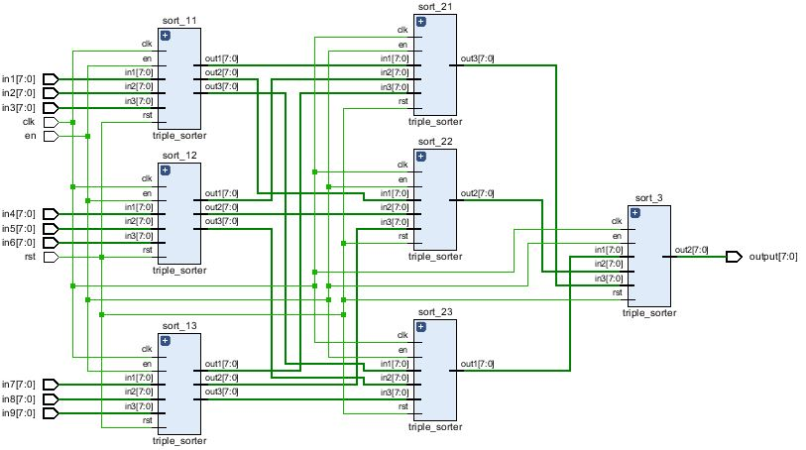
Design and Implementation
Datapath:
Notes:
Liming

Slide 9
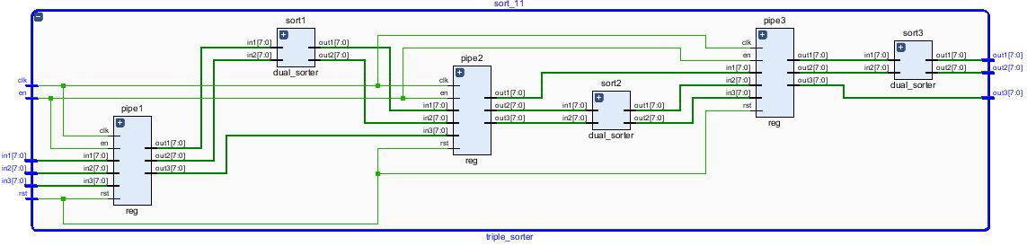
Design and Implementation
Datapath:

Slide 10
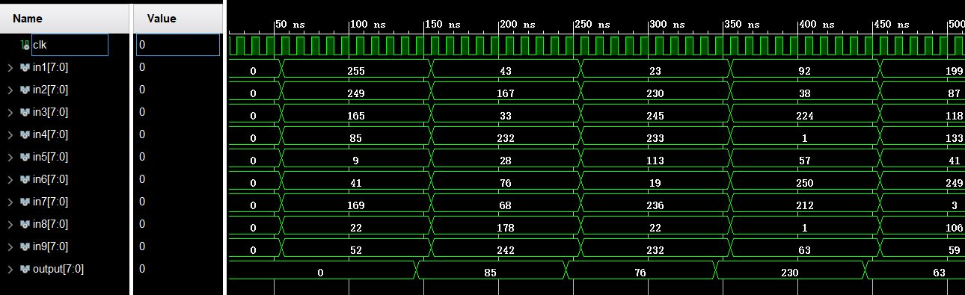
Design and Implementation
Datapath:
Latency: 3*3=9 cycles
Notes:
Liming

Slide 11
Design and Implementation - AWS
Notes:
Medini

Slide 12
Design and Implementation - AWS
Notes:
Medini

Slide 13
Block Diagram
ADDRESS
GENERATOR
B
R
A
M
1
B
R
A
M
2
B
R
A
M
3
MEMORY MAP
CONTROLLER
SMART BUFFER 1
SMART BUFFER 2
SMART BUFFER 3
GLUE LOGIC
DATAPATH
ADDRESS
GENERATOR
BRAM 4
Notes:
Medini

Slide 14
Testing & Demonstration – Software
A set of popular test images were used to compare the results of the MATLAB function and the C++ code
In the final presentation, results from the MATLAB function will be used for visual comparison with the hardware results
Whereas, results from the C++ code will be used to compare the speedup with the hardware implementation
Notes:
Anushka

Slide 15
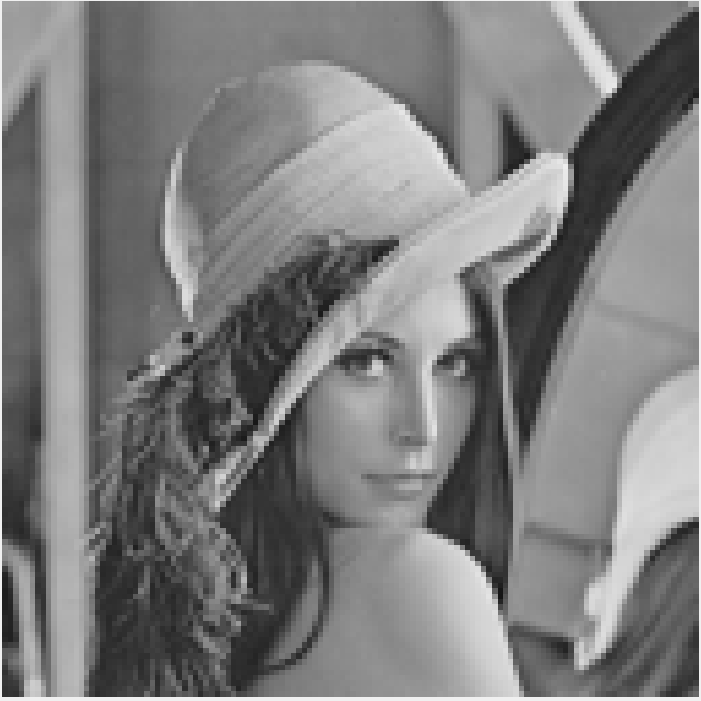

Results – MATLAB
Original Image (128X128)
Output Image - medfilt2() (128X128)
Notes:
Anushka

Slide 16
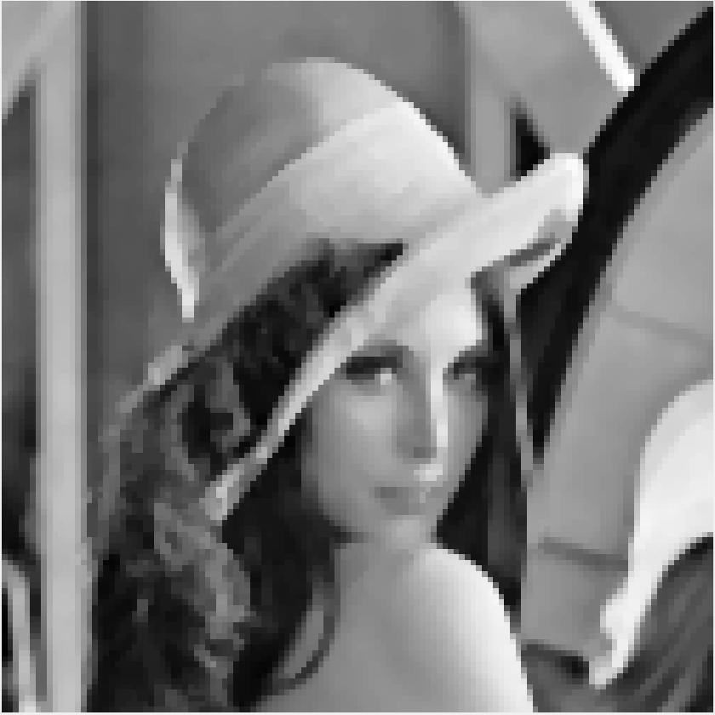
Results – C++
Original Image (128X128)
Output Image - C++ (126X126)
Notes:
Anushka

Slide 17
Salt & Pepper Noise
The median filter is said to be most efficient in removing salt & pepper noise from images
So we created noisy images by adding salt & pepper noise to original images using MATLAB
Notes:
Anushka

Slide 18
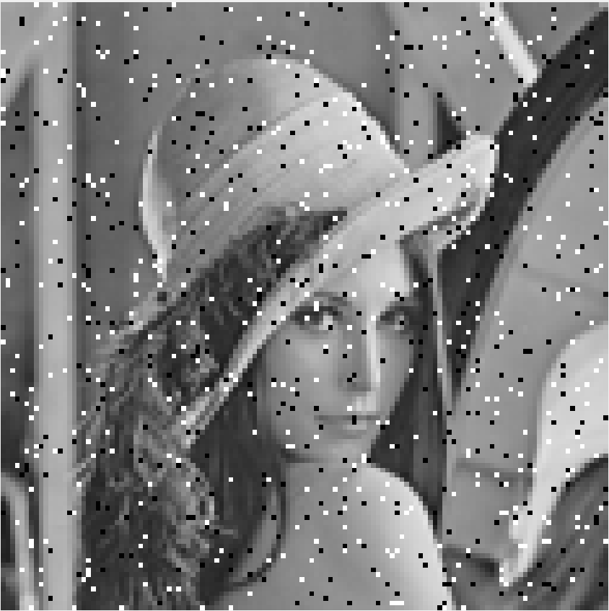

Results – MATLAB
Input Image – Salt & Pepper Noise (128X128)
Output Image - medfilt2() (128X128)
Notes:
Anushka

Slide 19
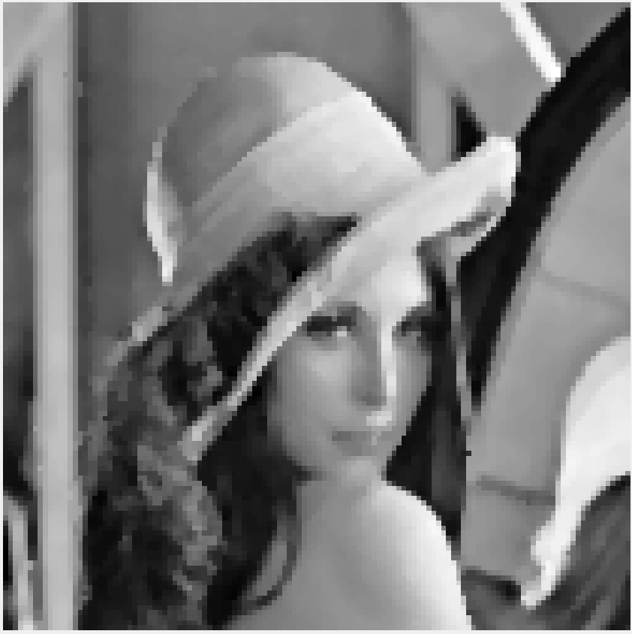
Results – C++
Input Image – Salt & Pepper Noise (128X128)
Output Image - C++ (126X126)
Notes:
Anushka

Slide 20
MATLAB Output
C++ Output
Without Noise
With Noise

Slide 21


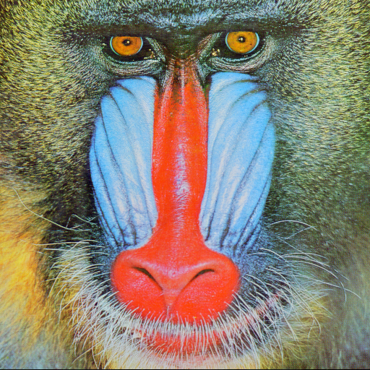
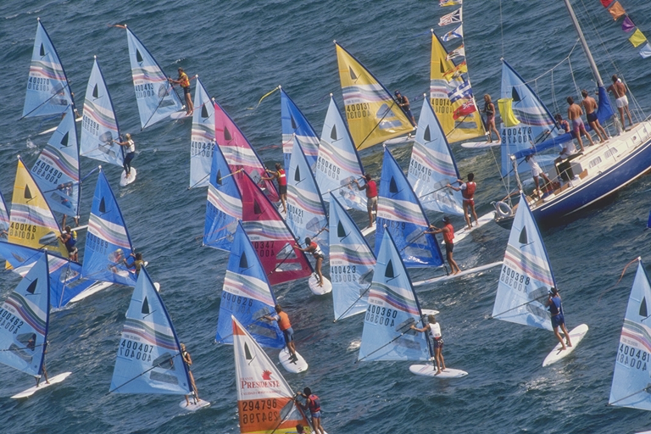
Dataset Used
Notes:
Anushka

Slide 22
Testing & Demonstration – AWS
Notes:
Medini

Slide 23
Future Work
Hardware Implementation, debugging & Testing
AWS implementation of Median Filter
Timing speedup comparison between software(C++) and hardware (FPGA) implementation.
Comparison of Images obtained from software (MATLAB) and Hardware (FPGA) implementations.
Analysis of results.
Report writing & Presentation
Notes:
Medini

